Slide 1

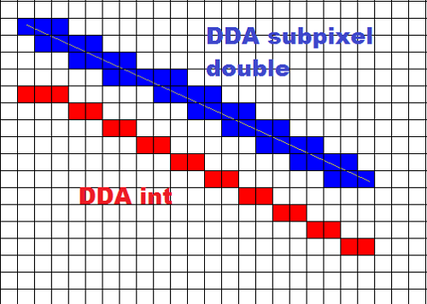
Lecture 3
Digital Differential Analyzer (DDA) Line drawing Algorithm
Prepared by Tapasy Rabeya Senior Lecturer CSE, DIU | Course Teacher Nushrat Jahan Oyshi Lecturer CSE, DIU
Department of CSE, Daffodil International University
Notes:
‹#›

Slide 2
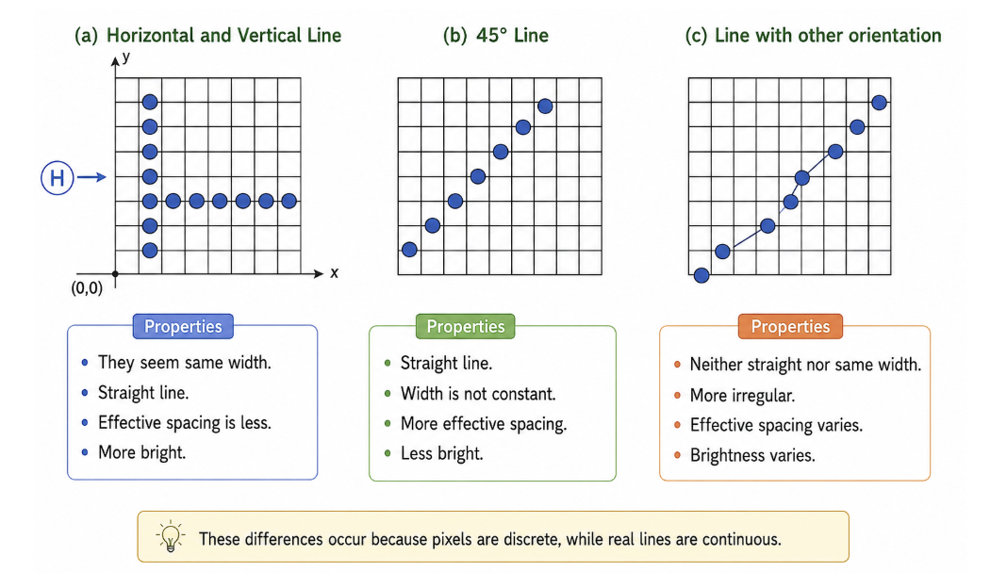
Line Drawing Algorithm
The line drawing algorithm is a graphical algorithm which is used to represent the line segment on discrete graphical media, i.e., pixel based media.
Department of CSE, Daffodil International University
‹#›

Slide 3
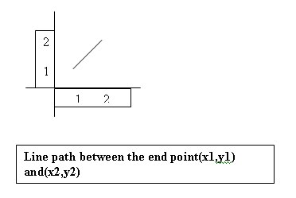
Line Equation
The Cartesian slope intercept equation for a straight line is, y= mx+c -------- (1) with m denotes the slope, c denotes the y intercept.
The 2 end points of a line segment are specified at a position (x1,y1) and (x2,y2).
Department of CSE, Daffodil International University
‹#›

Slide 4
Line DDA Algorithm
The digital differential analyzer (DDA) is a scan conversion line algorithm based on calculation either Dy or Dx.
The line at unit intervals is one coordinate and determine corresponding integer values from the nearest line for the other coordinate.
Consider first a line with positive slope.
Department of CSE, Daffodil International University
‹#›

Slide 5
Line DDA Algorithm
Steps:
Calculate the slope, m from (x₁,y₁) and (x₂,y₂)
Identify the case
Calculate y_{k+1} and x_{k+1} according to the identified case
Generate the iteration table from (x₁,y₁) until you reach (x₂,y₂) using the formula for y_{k+1} and x_{k+1}
Department of CSE, Daffodil International University
‹#›

Slide 6
Line DDA Algorithm cont..
Case : 1
If the slope is less than or equal to 1 or |D_{x}|>=|D_{y}|
then assign D_{x} = 1. Using D_{x} compute each successive y values.
D_{x} = 1
m = D_{y} / D_{x} m = ( y₂ – y₁ ) / 1
m = (y_{k+1} – y_{k})/ 1 y_{k+1} = y_{k} + m
Department of CSE, Daffodil International University
‹#›

Slide 7
Line DDA Algorithm cont..
Case : 2
If the slope is greater than 1 or or |D_{x}|<|D_{y}|, then assign D_{y} = 1 and using D_{y} compute each successive x values.
D_{y} = 1 m = D_{y} / D_{x} m = 1 / (x₂ – x₁ ) m = 1 / (x_{k+1} – x_{k}) x_{k+1} = x_{k} + (1/m)
Department of CSE, Daffodil International University
‹#›

Slide 8
Line DDA Algorithm cont..
Case : 3
If the processing is reversed for Case 1, the starting point at the right
D_{x} = -1
m = D_{y} / D_{x} m = ( y₂ – y₁ ) / -1 y_{k+1} = y_{k} - m
Department of CSE, Daffodil International University
‹#›

Slide 9
Line DDA Algorithm cont..
Case : 4
If the processing is reversed for Case 2, the starting point at the right
Here, D_{y} = -1 m= D_{y} / D_{x} m = -1 / (x₂ – x₁ ) m = -1 / (x_{k+1} – x_{k}) x_{k+1} = x_{k} – (1/m)
Department of CSE, Daffodil International University
‹#›

Slide 10
Example
Draw a line using DDA algorithm between points (5,4) and (12,7)
Step 1: Calculate Δx and Δy,
Δx = 12 − 5 = 7
Δy = 7 − 4 = 3
Step 2: Calculate the number of steps,
Steps = max(|Δx|, |Δy|)
Steps = max(7,3) = 7
Step 3: Calculate the x_inc and y_inc values,
x_inc = Δx / Steps = 1
y_inc = Δy / Steps = 3/7 ≈ 0.43
Department of CSE, Daffodil International University
‹#›

Slide 11
Iteration Table using Round-off Function
Step | x | y | Rounded Pixel
0 | 5.00 | 4.00 | (5,4)
1 | 6.00 | 4.43 | (6,4)
2 | 7.00 | 4.86 | (7,5)
3 | 8.00 | 5.29 | (8,5)
4 | 9.00 | 5.72 | (9,6)
5 | 10.00 | 6.15 | (10,6)
6 | 11.00 | 6.58 | (11,7)
7 | 12.00 | 7.00 | (12,7)
Department of CSE, Daffodil International University
‹#›

Slide 12
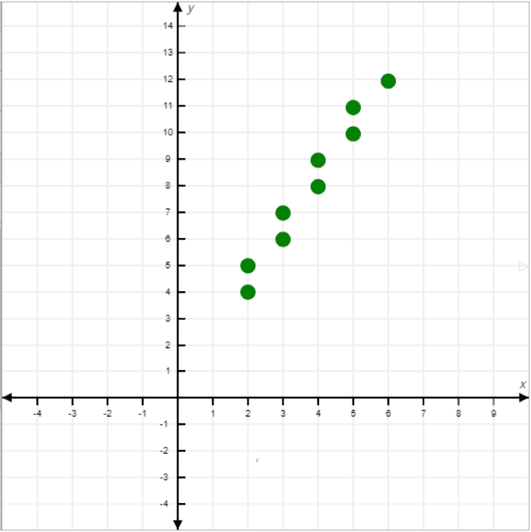
Example
Department of CSE, Daffodil International University
‹#›

Slide 13
Advantage
Simple and Easy to Understand
Algorithm is straightforward
Easy to implement and explain in exams
Faster Than Naive Line Drawing
More efficient than directly evaluating the line equation
Works for All Slopes
Can draw lines with any slope
Handles horizontal, vertical, and diagonal lines
Uniform Pixel Generation
Generates pixels at equal intervals
Produces reasonably smooth lines
Good for Software Implementation
Suitable for learning and basic graphics programs
Department of CSE, Daffodil International University
‹#›

Slide 14
Disadvantage
Uses Floating-Point Arithmetic
Requires real (fractional) calculations
Slower compared to integer-based algorithms
Rounding Errors Accumulate
Repeated rounding of coordinates can cause slight deviation from the ideal line
Lower Efficiency
More computation per pixel
Not suitable for high-performance graphics systems
Less Accurate Than Bresenham’s Algorithm
Bresenham uses integer arithmetic
Produces more precise pixel placement
Not Hardware Friendly
Floating-point operations are expensive in hardware implementation
Department of CSE, Daffodil International University
‹#›

Slide 15

Department of CSE, Daffodil International University
‹#›
Notes:
‹#›

